Slide 1


SELENIUM TESTING
&
DOCKER
By: Aditi Jha
ID: 201345
Trainer: Sachin Vasav

Slide 2
TABLE OF CONTENT
Introduction​ of Selenium
Components for Selenium
Introduction of Docker
Our Project
Selenium Testing
Docker

Slide 3

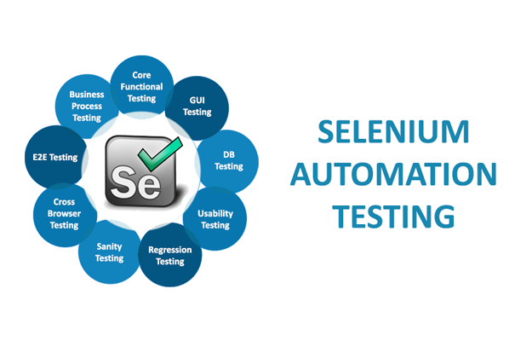
INTRODUCTION OF SELENIUM
Testing
•Selenium is a free (open-source) automated testing framework.
•Used to validate web applications across different browsers and platforms. Multiple programming languages like Java, C#, Python, etc to create Selenium Test Scripts.
•Testing done using the Selenium testing tool is usually referred to as Selenium Testing.

Slide 4
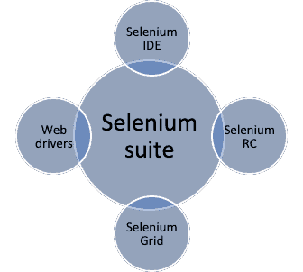
COMPONENTS OF SELENIUM
•Selenium IDE(Integrated Development Environment) : allows for recording, editing and debugging of functional tests.
•Selenium RC (Remote control) write automated tests for a web application in any programming language, which allows for better integration of Selenium in existing unit test frameworks.
•Selenium Web Driver : accepts commands and sends them to a browser.
•Selenium Grid : server that allows tests to use web browser instances running on remote machines.

Slide 5
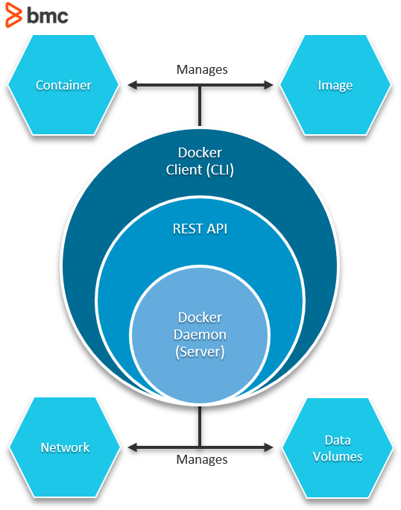
INTRODUCTION TO DOCKER
•Docker is a set of platforms as a service (PaaS) products that use the Operating system level virtualization to deliver software in packages called containers.
•Containers are isolated from one another and bundle their own software, libraries, and configuration files.
•They can communicate with each other through well-defined channels.
•All containers are run by a single operating system kernel and therefore use fewer resources than a virtual machine.

Slide 6



OUR PROJECT
Creating Docker image and deploying in docker container.
Process 01
Selenium Testing
Process 02
Docker

Slide 7
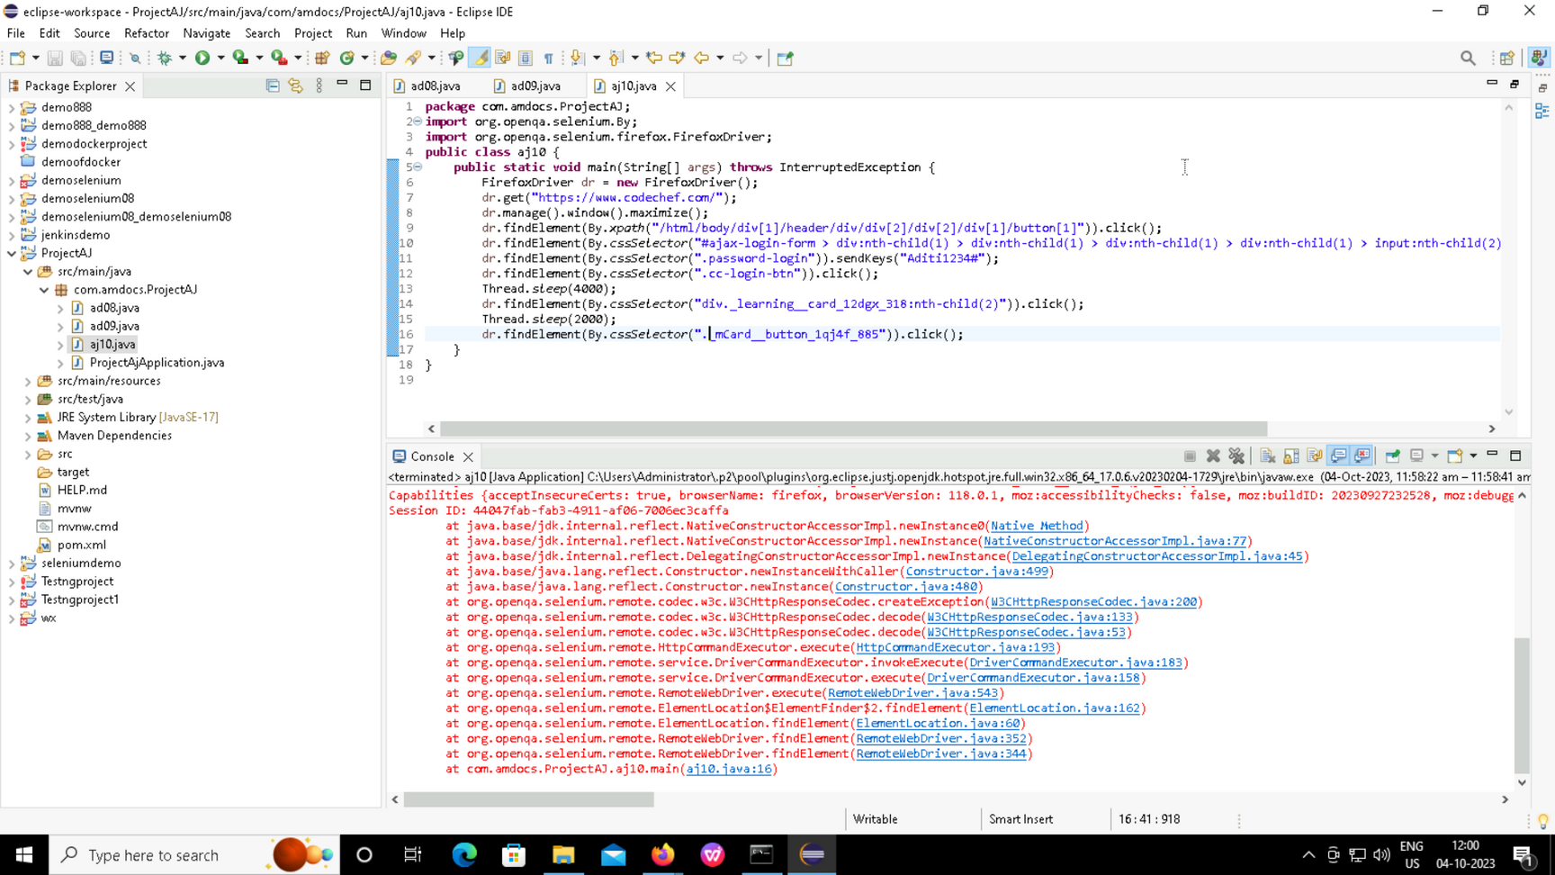
SELENIUM TESTING
Selenium Testing on CodeChef Website

Slide 8
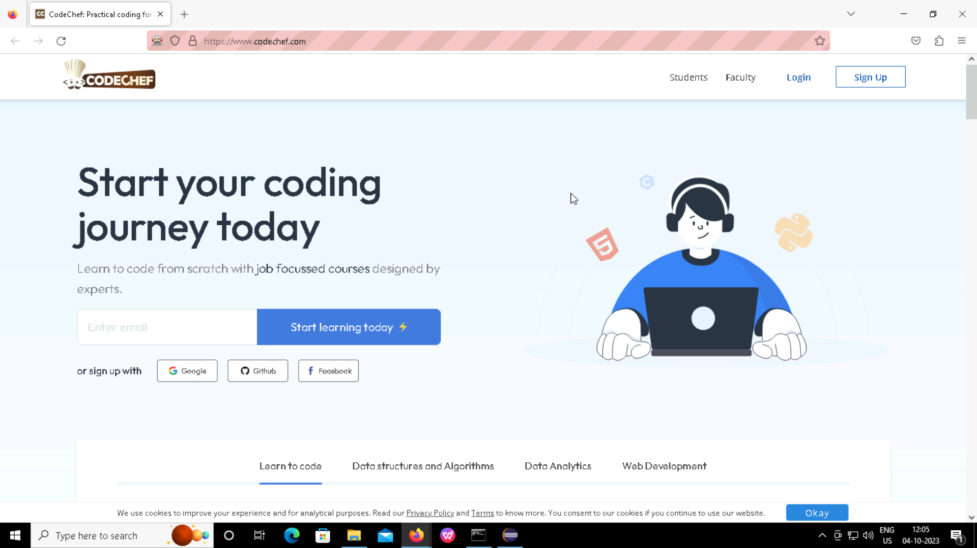

Selenium Testing Output
Opened the Home page

Slide 9
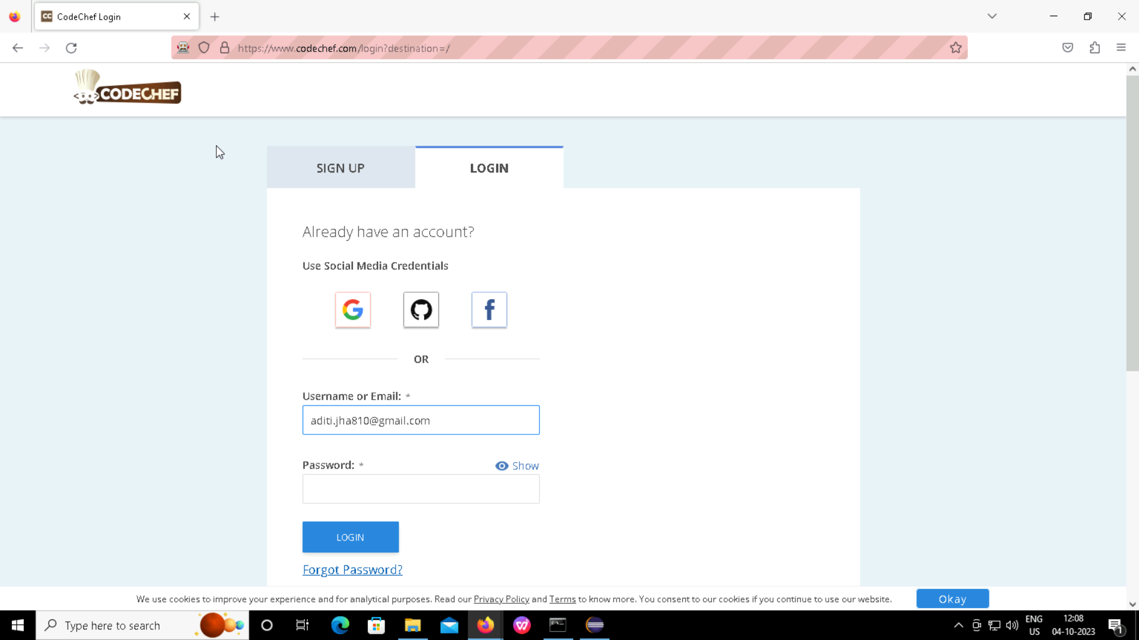

Obtaining email id as a Output
Obtaining password as a Output

Slide 10
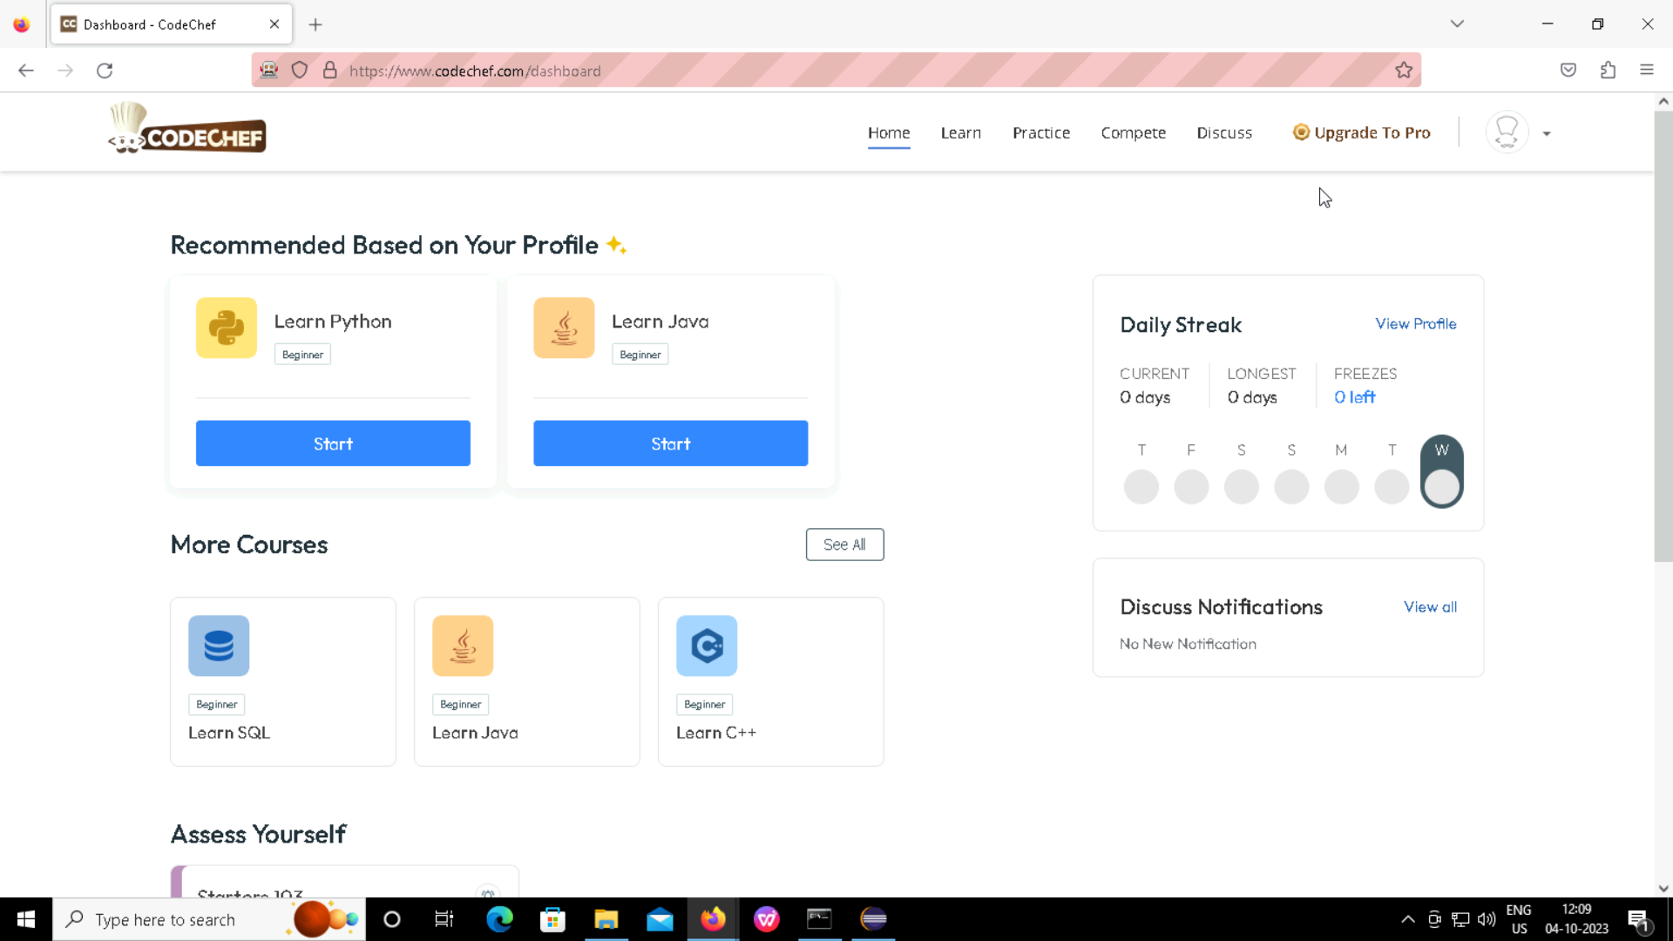
Logged in the Home page

Slide 11
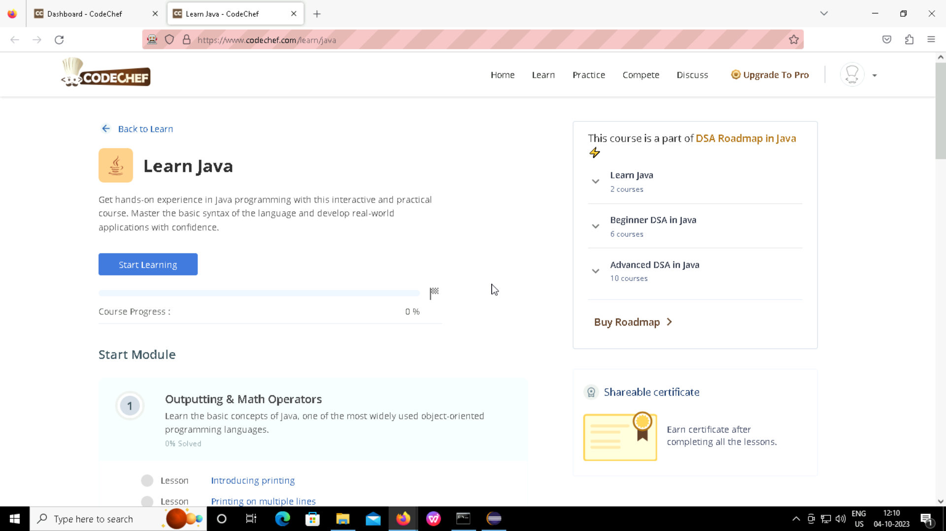
Used Click Operation on Java Programming

Slide 12
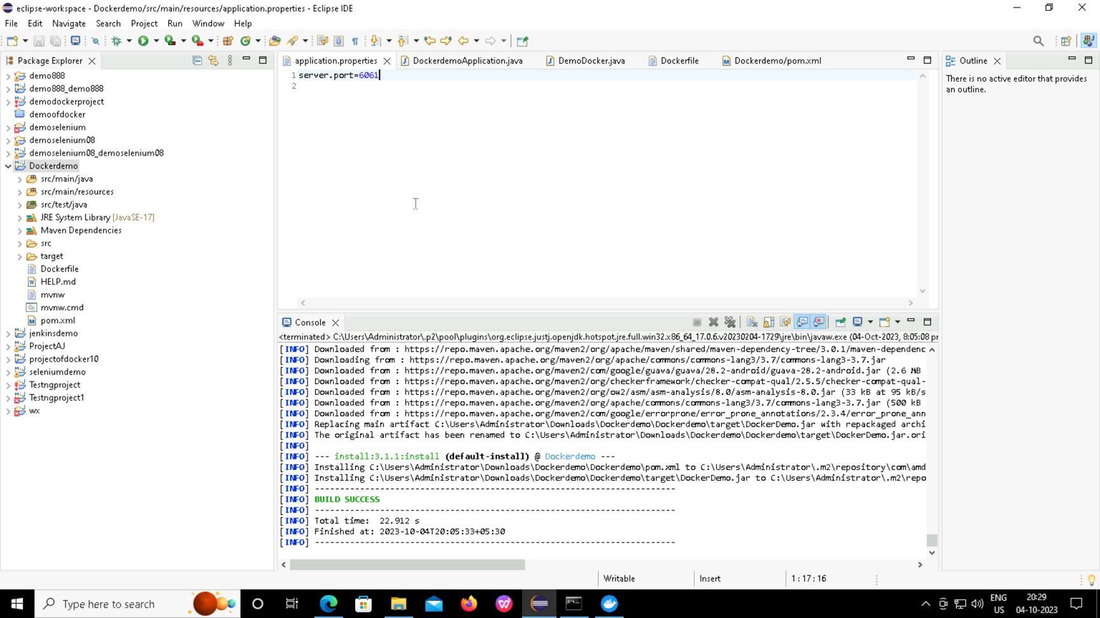
DOCKER
Code for Application properties

Slide 13
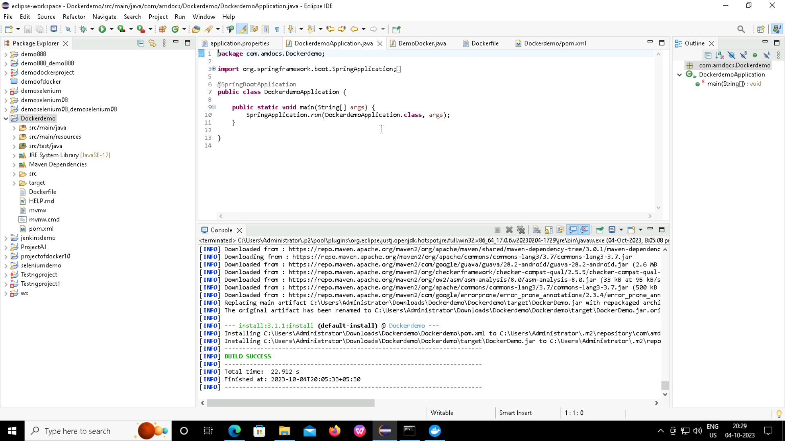
Code for Docker Application

Slide 14
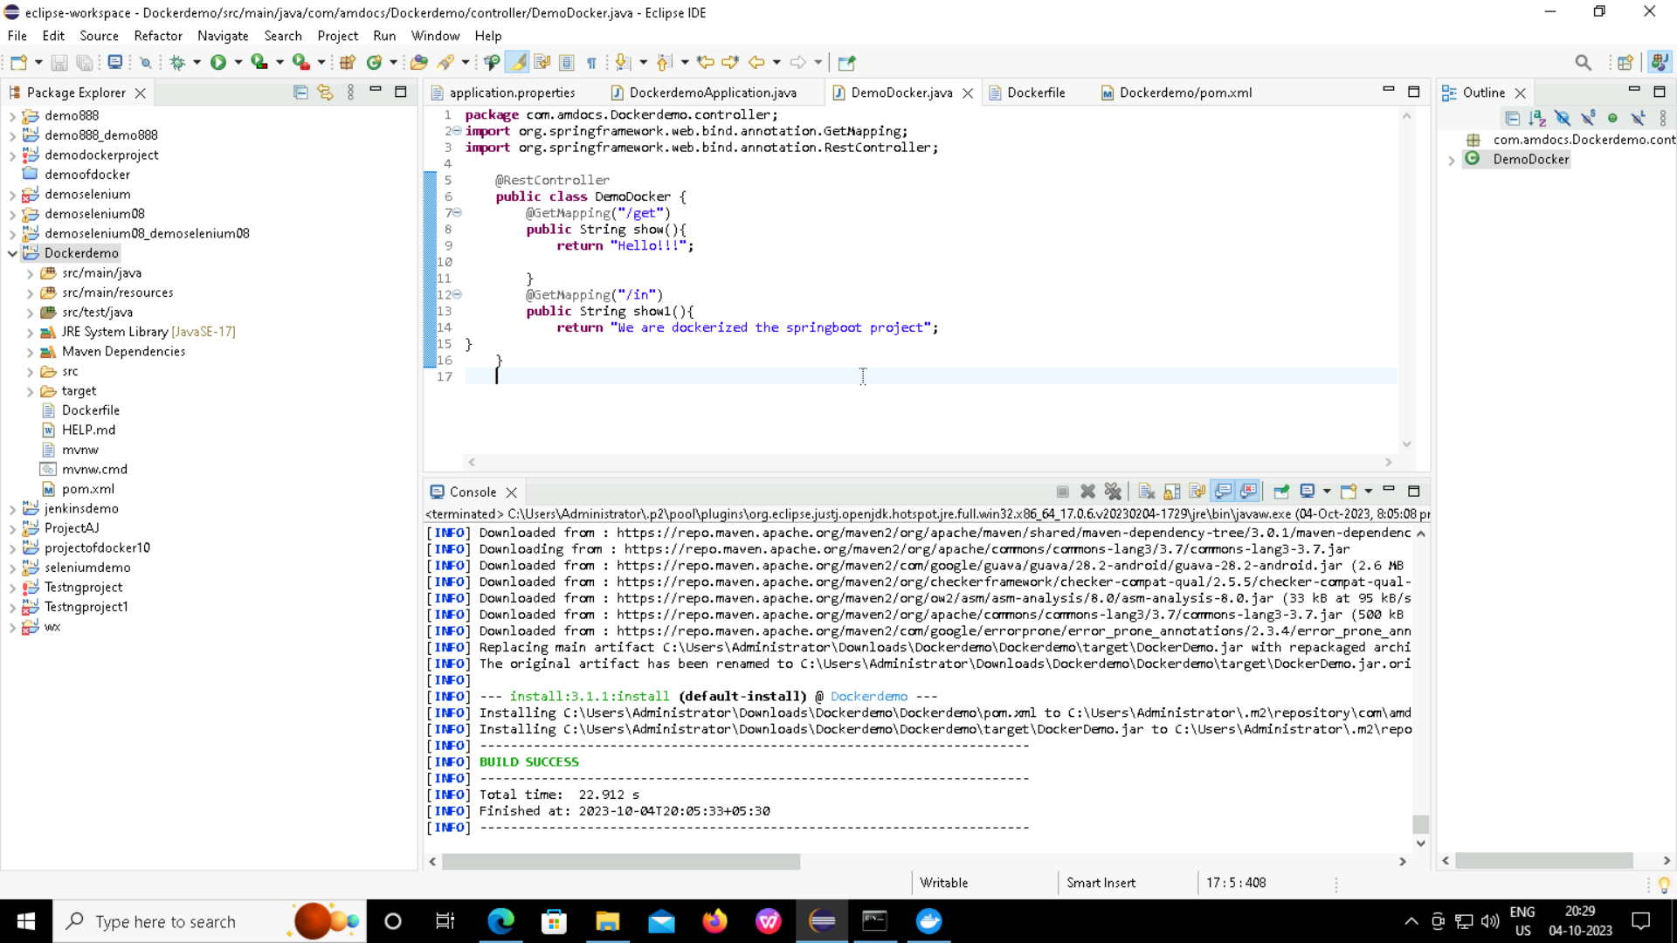
Code for Docker by providing get and in operations

Slide 15
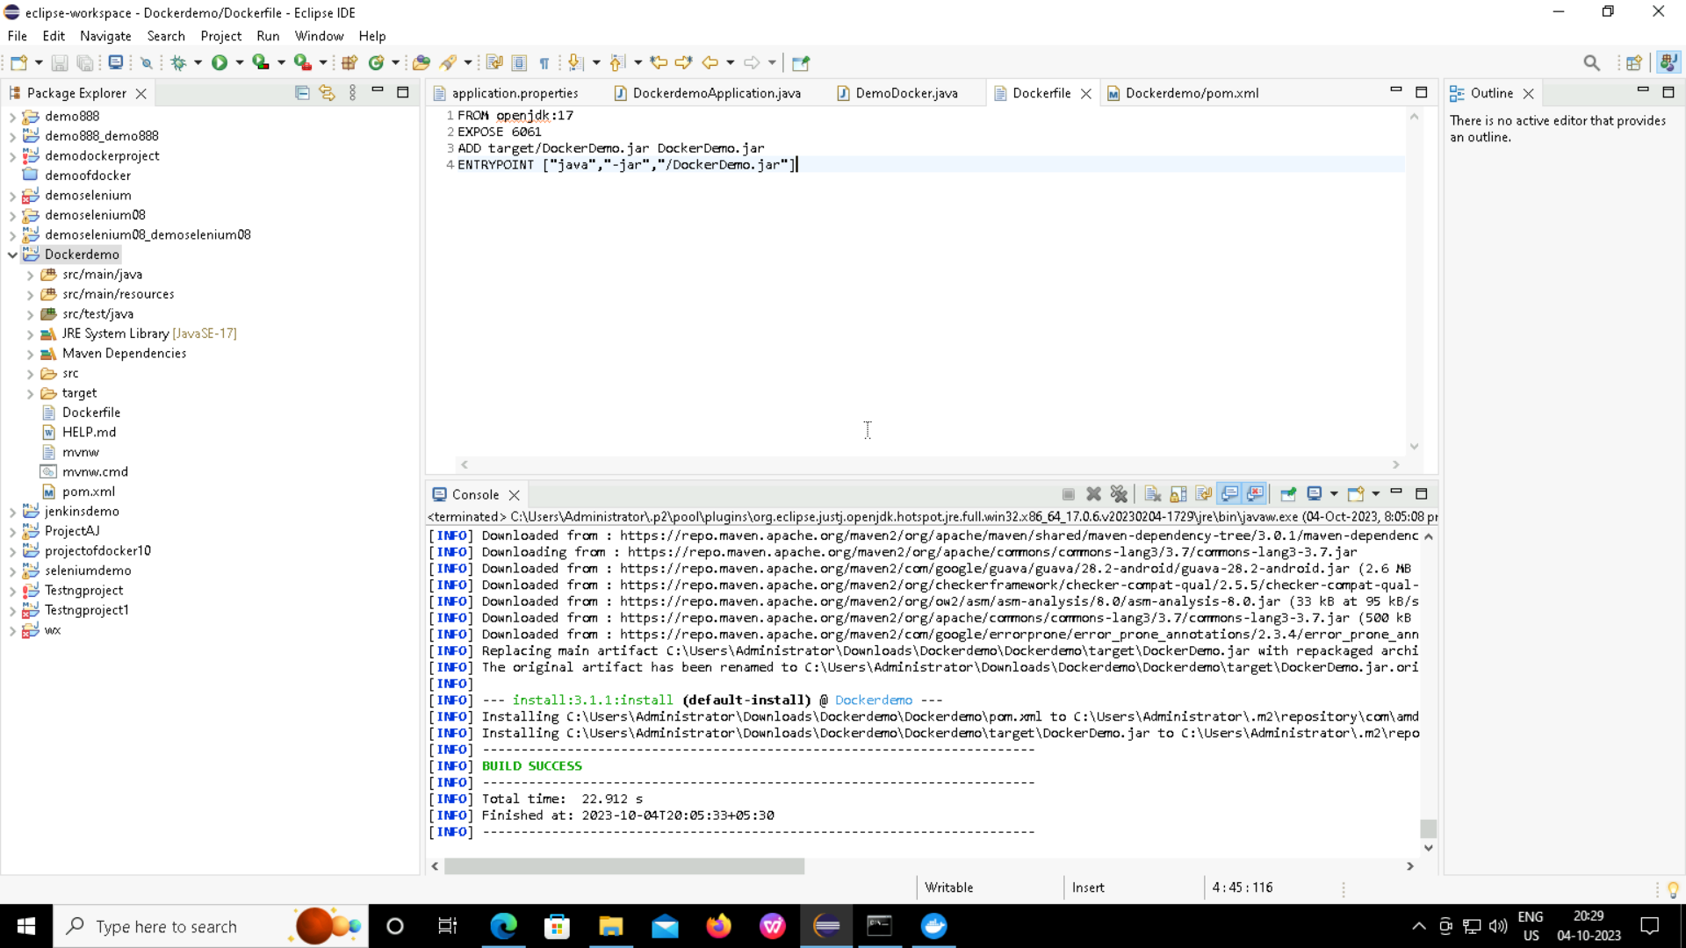
Code for Docker File

Slide 16
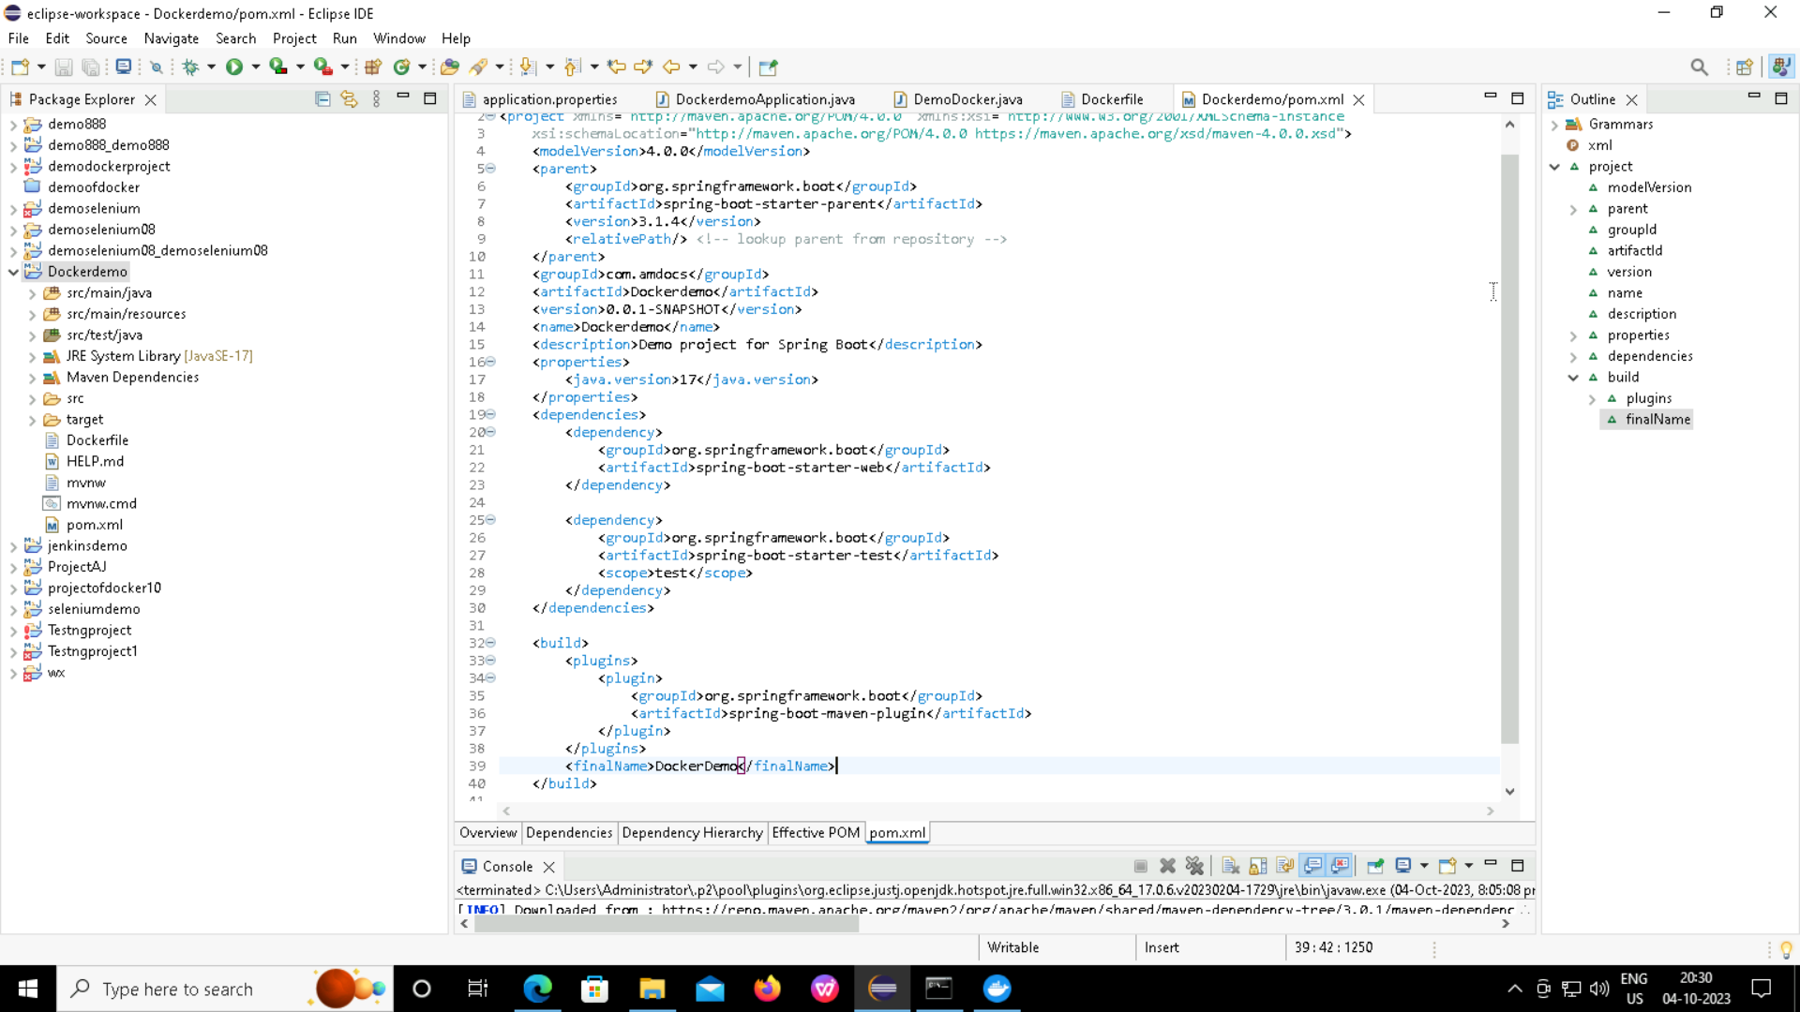
Dependencies in for Pom.xml

Slide 17
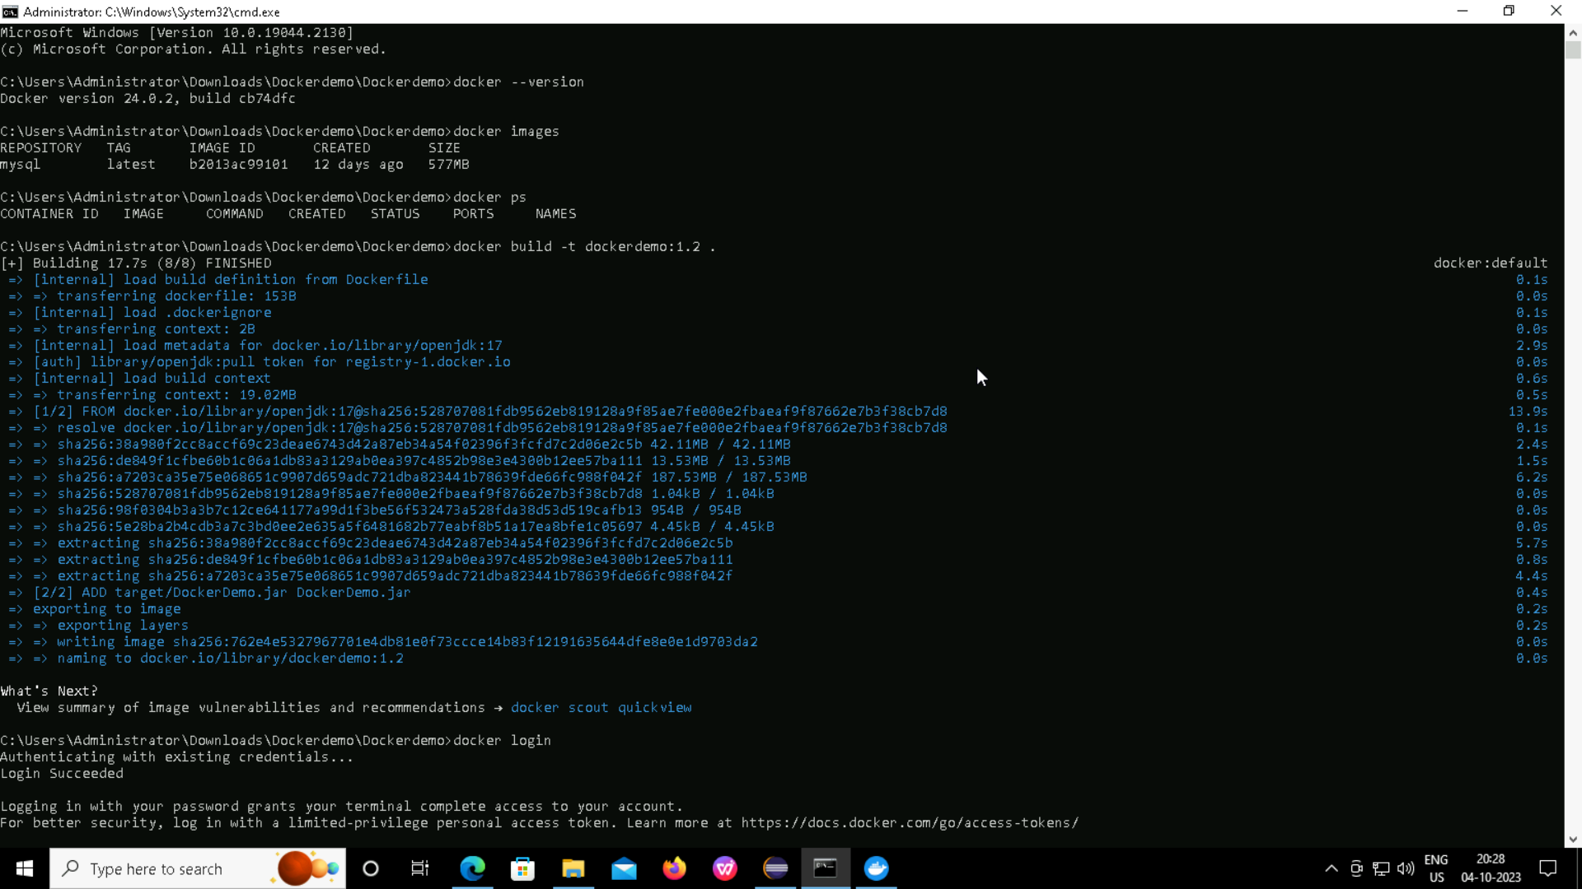

Slide 18
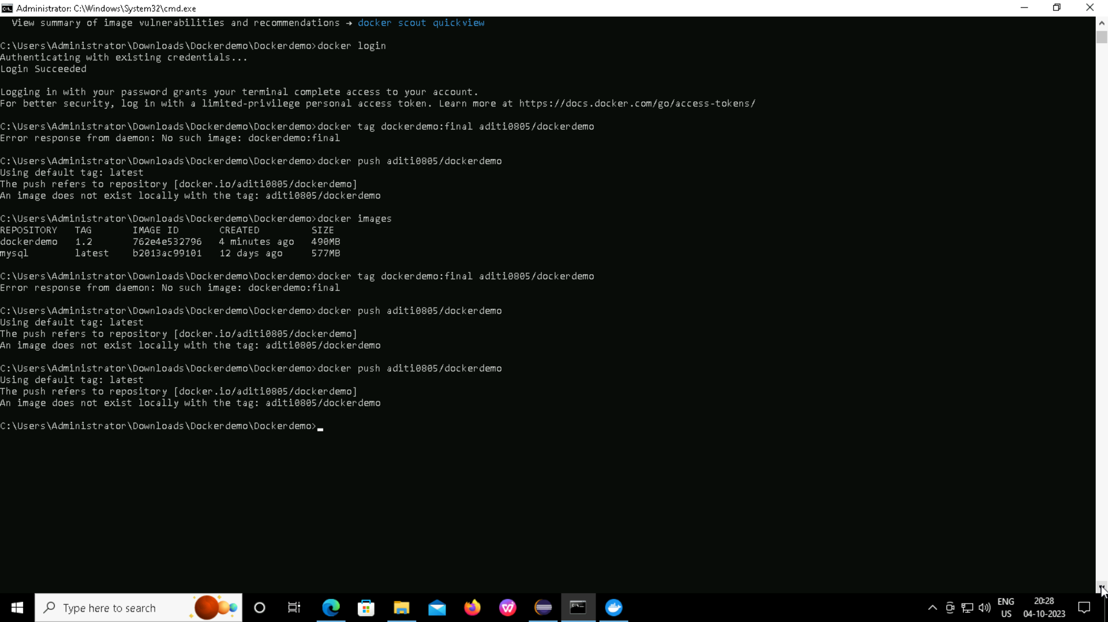

Slide 19
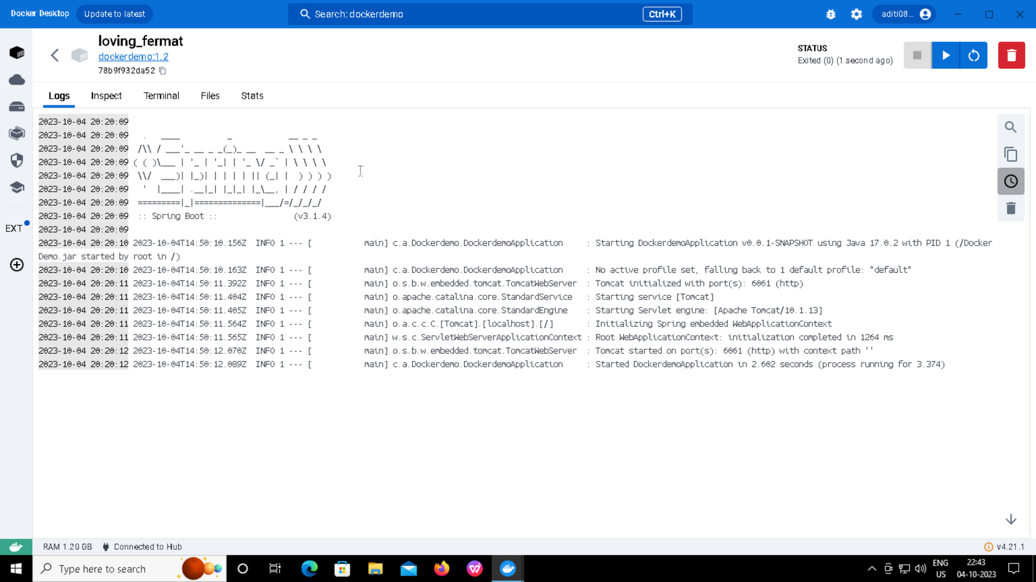
Output Screen of Docker

Slide 20
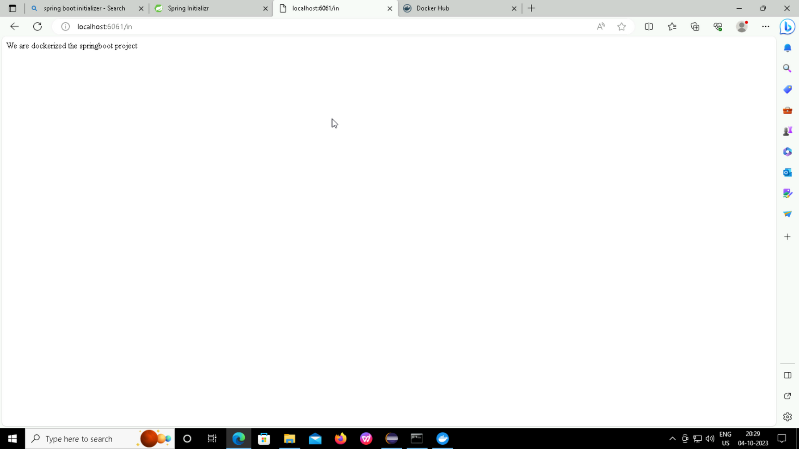
output Screen after searching on local host for in command

Slide 21

output Screen after searching on local host for get command

Slide 22
THANK
YOU

